Slide 1
Order Pattern Analysis Using Data Visualization
Exploring Customer Segments, Regions, and Market Trends
Harshitha Dhanekula Navaneeth Reddy
MSDS670 – Data Visualization

Slide 2
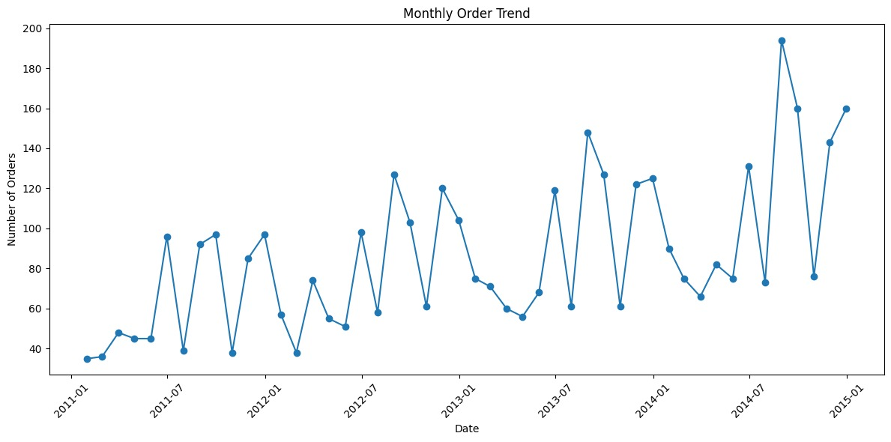
Monthly Order Trend (2011–2014)
Order volume increases steadily across the four-year period.
Monthly fluctuations suggest seasonal demand changes.
Overall growth indicates expanding business activity.

Slide 3
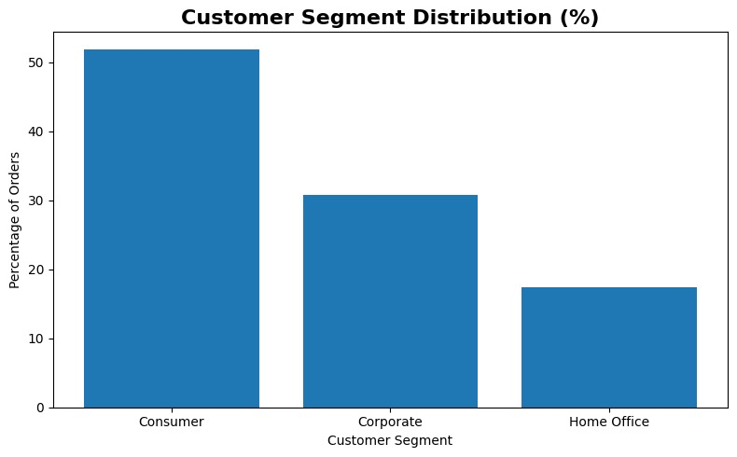
Customer Segment Distribution (%)
Consumer customers represent the largest portion of total orders.
Corporate customers contribute a significant secondary share.
Home Office customers account for the smallest percentage.

Slide 4
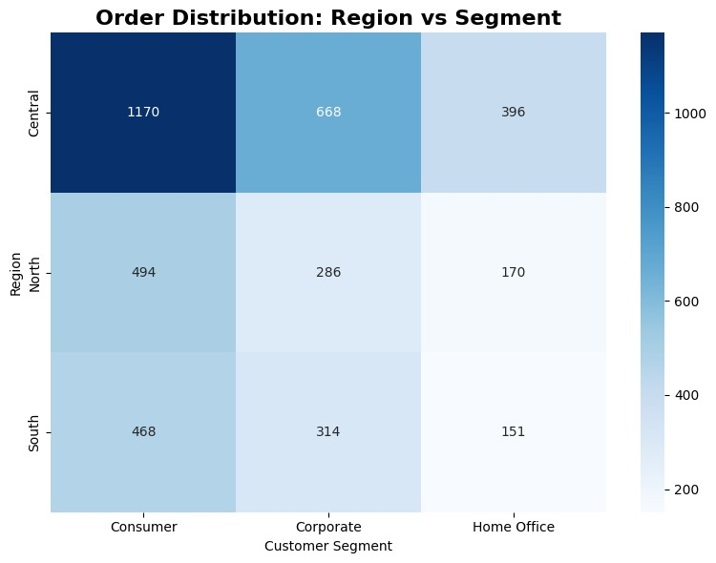
Order Distribution by Region and Segment
The Central region records the highest order volume.
Consumer customers dominate across all regions.
Home Office customers contribute the smallest order counts.

Slide 5
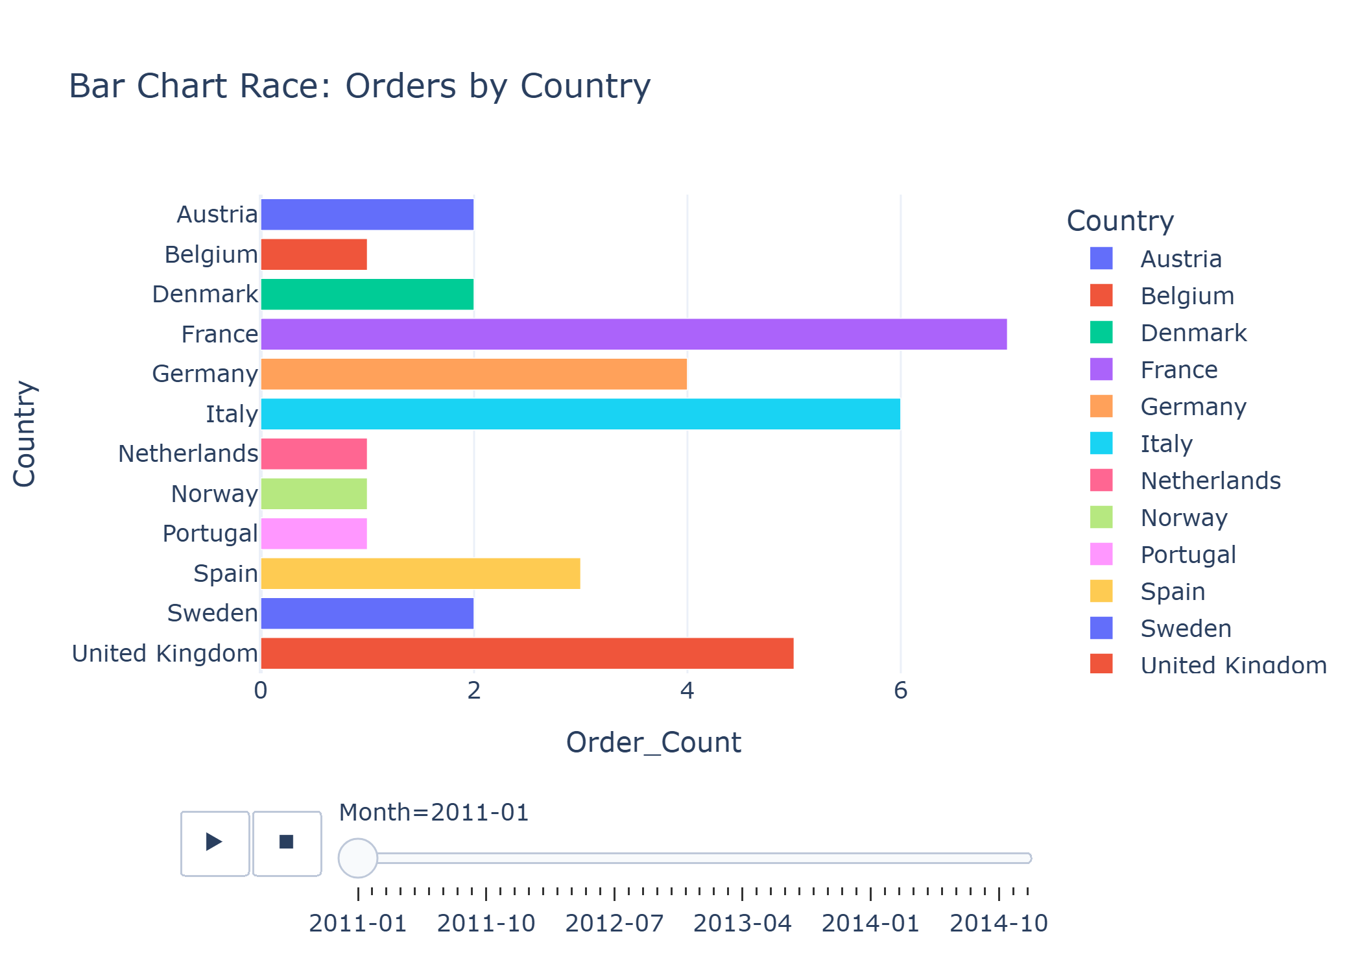
Orders by Country Over Time
Certain countries consistently generate higher order volumes.
Rankings shift over time as demand changes across markets.
The animation highlights evolving geographic order patterns.

Slide 6
Conclusions
Key Insights
Order volume shows steady growth from 2011 to 2014.
Consumer customers drive most demand.
Geographic differences reveal varying market activity across regions and countries.

